Slide 1
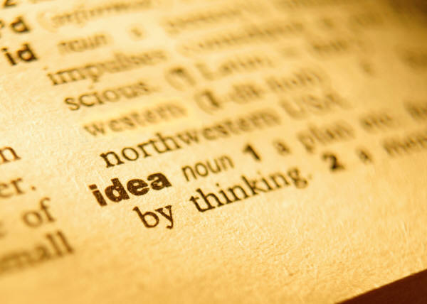
Vocabulary 1

Slide 2
Ag: do, lead, drive
Agenda—a “to do” list
Agent—an active force
Aggravate—to make worse

Slide 3
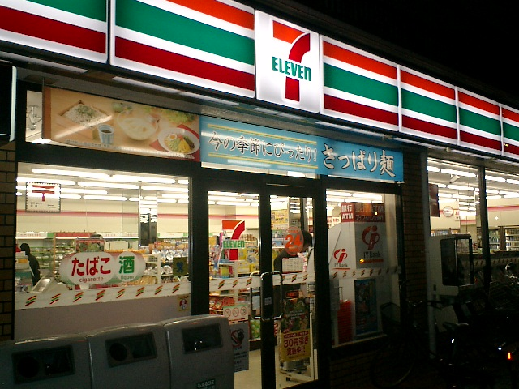
Ven/vent—come; come together
Convention—a meeting or formal assembly for discussion of or action on particular matters of common concern
Convenience store—a retail store that brings together a limited selection of basic items and is open long hours

Slide 4
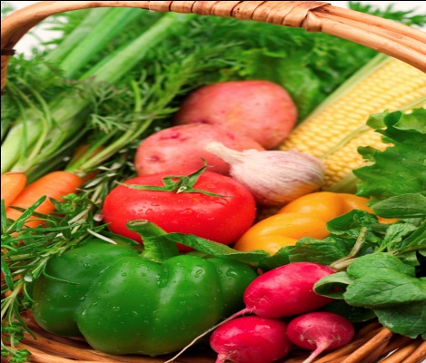
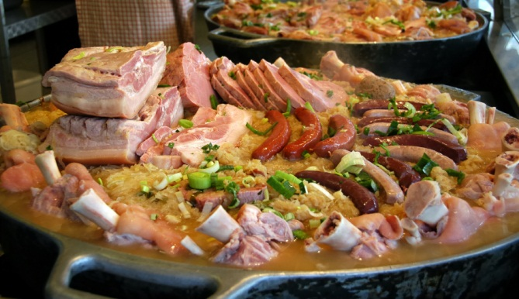
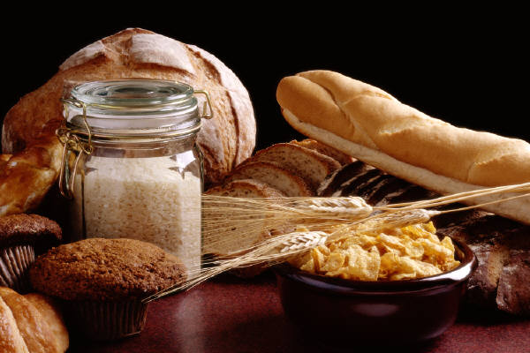
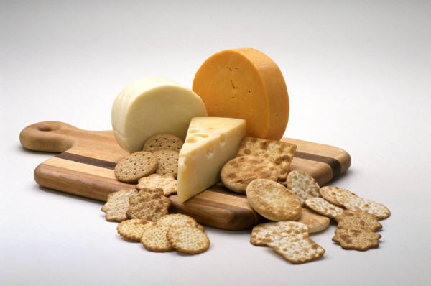
Omni: all
Omnipotent—all powerful
Omnipresent—present in all places
Omnivorous—eating all foods

Slide 5

Fin: end or boundary
Final—coming at the end
Finale—the concluding or ending part of a musical work (or fireworks display!)

Slide 6

Auto: Self
Autobiography—the story of one’s own life.
Autonomous—existing or
functioning independently

Slide 7
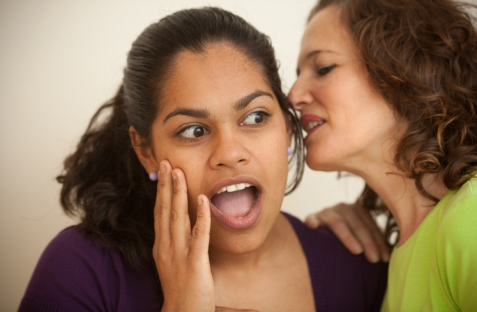
Prefix
Inter: between
Interloper—one who meddles
Interlude—anything that fills time between two events
Intermission—interval of time between periods of activity (as between the acts of a play)

Slide 8
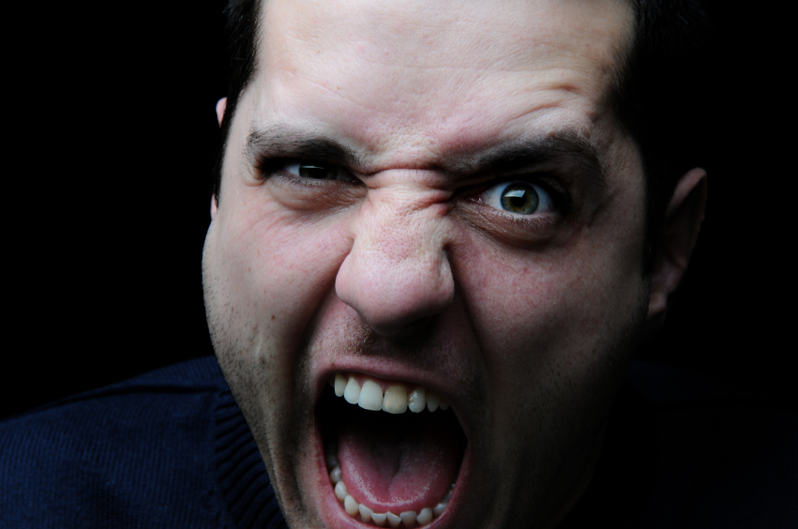
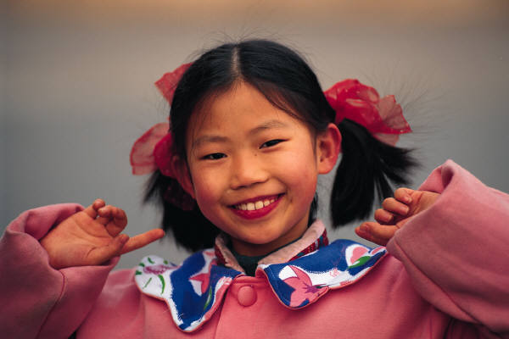
Suffix
--ity: state of being
Enmity—bitter feelings or hostility
Felicity—happiness

