Slide 1
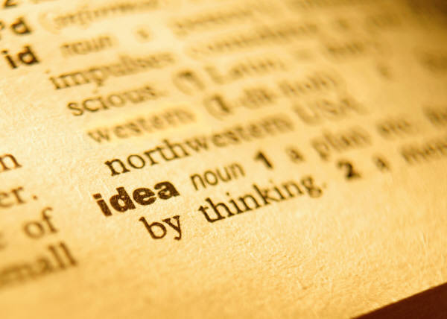
Vocabulary #4

Slide 2
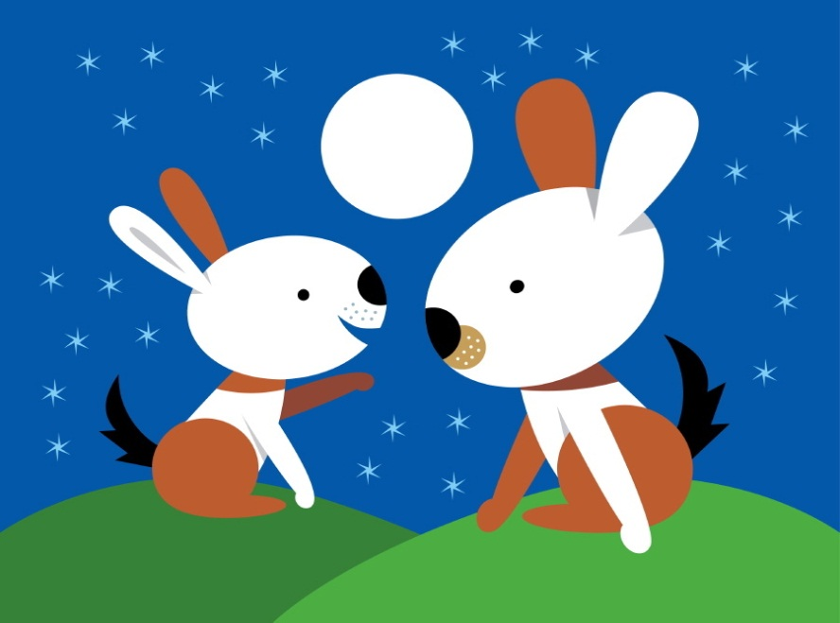
Dict: say
Diction—
1.) Style of speaking or writing dependent upon choice of words.
2.) Enunciation
Dictation—the act of
writing down words spoken
by another

Slide 3

Graph: write
Autograph—a person’s signature
Graphite—a common mineral
used in making lead for
pencils

Slide 4
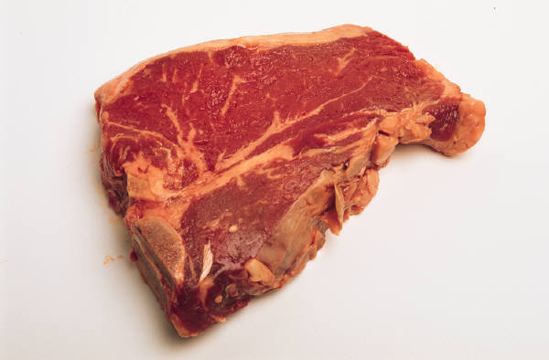

Carn: flesh
Carnivore—an animal
that eats flesh
Carnation—pink, light red;
the color of flesh

Slide 5
Cred: to believe
Credence—belief as to the truth of something
Credit—confidence in a purchaser’s ability and
intention to pay

Slide 6
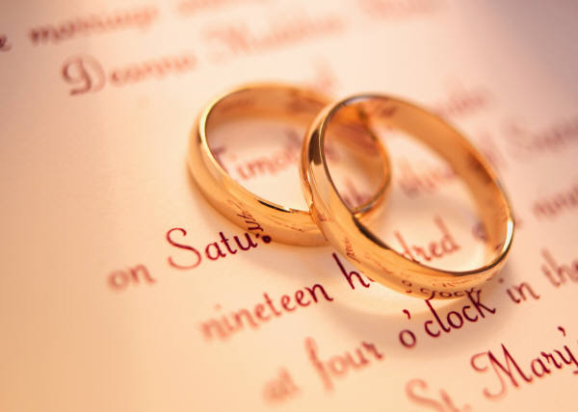
Fid: faith
Fidelity—observance of
promises; loyalty
Fiduciary—a person to whom
property or power is
entrusted for the benefit
of another

Slide 7


Prefix
Over-: over; too much
Overwrought—extremely
excited or agitated
Overdraft—the act of
overdrawing a checking
account

Slide 8
Suffix
--ness: state or condition of
Loneliness—the depressing
feeling of being alone
Preparedness—the state of
being prepared

