Slide 1
Vocabulary #5

Slide 2
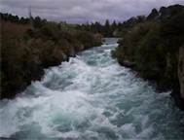
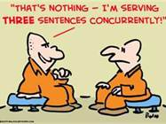
Cur/curs: to run (as in move)
Current — a flowing; flow, as of a river
Concurrently –
occurring or existing simultaneously

Slide 3
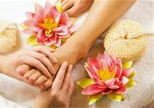
Ped: foot; child
Pediatrician – a doctor who specializes in the branch of medical science concerned with children and their diseases
Pedicure — professional care and treatment of the feet

Slide 4
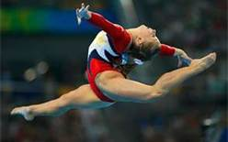
Flect/flex: to bend
Flexible – easily bent
Inflection – modulation of the voice

Slide 5
Post: after or behind
Posthumous – happening or continuing after one's death
Postpone – defer, delay

Slide 6
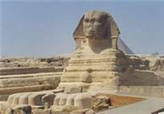
Crypt/cryph: hidden
Cryptic – mysterious in meaning; puzzling
Encrypt – to put (a message) into code

Slide 7
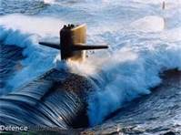
Prefix sub- : under
Subconscious – acting or existing without one's awareness
Submarine – a vessel that can be submerged and navigated under water, usually built for warfare and armed with torpedoes or guided missiles

Slide 8
Suffix --ous: possessing qualities of
Nervous – unnaturally or acutely uneasy or apprehensive
Ambidextrous – able to use both hands equally well

