Slide 1
Tuesday, 9/8/15
Brit Lit:
Please take out a blank sheet of paper and something to write with
World Lit:
Please grab a handout from the Tuesday folder and begin reading the side titled “Detail”. You should underline, circle, and take notes as you go.

Slide 2
Brit Lit: Consider each of the following statements
On your paper, number 1-6. For each statement below decide whether you AGREE or DISAGREE. You need to have support for each of your decisions. Tell me why. We will be discussing these topics as a class when we finish.
Women are more romantic than men.
A mate’s physical attractiveness is far more important to men than it is to women.
Women aren’t interested in casual sex.
Men and women have fundamentally different personalities and orientations toward relationships.
Men and women have fundamentally different ways of handling conflict.
Physical abuse in relationships is almost always committed by men.

Slide 3
World Lit: Voice Lesson on Details
Read the side titled “Details” take notes as you go.
At the bottom of that page, write an explanation in YOUR OWN WORDS about why details are important in writing.
Flip the page over and complete the Voice Lesson. All of your answers should be in complete sentences. Remember that a paragraph is 5-7 sentences long. Give your best effort.

Slide 4
Winners! Congratulations
1st block: Red Team (it was close between Red/Black, but Red barely won with attendance points)
2nd block: Blue Team
4th block: Black Team
Draw new teams!

Slide 5
Brit Lit: Read & Annotate
Each of you has been given a copy of the article from Psychology Today called “6 Myths About Men, Women, and Relationships”.
Please read and annotate this article keeping the following things in mind:
Don’t skip over words that you are unfamiliar with! Underline them, look them up (phone or dictionary on book shelf), and write the definition in the margins.
Underline claims (statements that the author is trying to prove).
Circle important details that support/weaken the authors claims make sure you note to the side whether they strengthen or weaken the argument.
Interact with the text. If you see something that you don’t agree with, put a star by it and write your thoughts to the side. If something supports your thoughts from the warm-up, make note of it!

Slide 6
Chivalry
Physical Ideals of Non-Physical Ideas of Knighthood Knighthood (Prowess)
Strength Courage
Skill at Arms Courtesy
Horsemanship Humility

Slide 7
The Code of Chivalry
I. Thou shalt believe all that the church teaches, and shalt observe all its directions.
II. Thou shalt defend the church.
III. Thou shalt respect all weaknesses and shalt constitute thyself the defender of them.
IV. Thou shalt love the country in which thou wast born.
V. Thou shalt not recoil before thine enemy.
VI. Thou shalt make war against the Infidel without cessation and without mercy.
VII. Thou shalt perform scrupulously thy feudal duties, if they be not contrary to the laws of God.
VIII. Thou shalt never lie and shalt remain faithful to thy pledged word.
IX. Thou shalt be generous and give largess to everyone.
X. Thou shalt be everywhere and always the champion of the right and the good against injustice and evil.

Slide 8
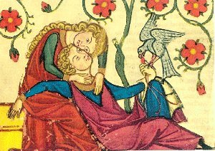
Courtly Love
The object of love was to be worshipped from afar as an ideal;
love was supposed to be an ennobling influence, and only noble people were worthy of love.

Slide 9
Courtly Love
Several influences built up to acceptance of courtly love:
Marriages of convenience in the 8th-16th centuries made adultery a way of life
Men had shorter life spans then women. Women could inherit and thus gain control of wealth
Men went away, leaving women in control, as they went to the Crusades to clear the holy land of infidels
The belief that the lady should be treated as infinitely desirable was fostered by women and by poets. The way of life portrayed in medieval romances influences real expectations of proper behavior.

Slide 10
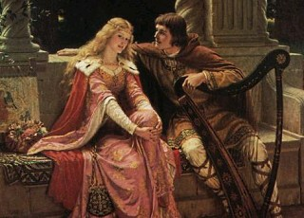
The Rules of Courtly Love
Courtly love or fin amor = the emphasis on graceful and idealized relations between the sexes.
Note: Courtly love is an almost entirely literary phenomenon.

Slide 11
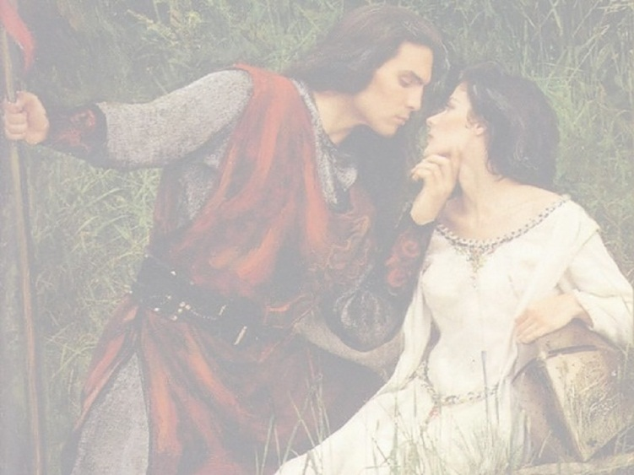
Medieval Romance
A tale of high adventure that can be a religious crusade, a conquest for the knight’s liege and lord or
the rescue of a captive lady or any combination of God, a goodly king and a pretty girl. Name “romance” derives from Old French (the language in which narrative was written), which is a “Romance” language, which descended from Latin, the
language of the ancient Romans.

Slide 12
Medieval Romance Characteristics
usually idealizes chivalry
idealizes the hero-knight and his noble deeds
contains the element of the knight's love for his lady
includes settings that tend to be imaginary and vague
derives mystery and suspense from supernatural elements
uses concealed or disguised identity
Often uses repetition of the mystical number "3." (Repetitions of the number or multiples of 3)

Slide 13
Brit Lit: “The Wife of Bath’s Tale” Pre REading
Who is the Wife of Bath?
Students with 1-pager?
Gender Stereotypes, Sexuality, Relationships, & Power

Slide 14
“Women in Afghanistan” article quiz
Everyone will take this except the following people: Christian, Amari, Zane, Kathylee, Chancey, Daniel, Ashley, Dalton, Bilal, James N., James T., Esher, Jibri, Olcen,
What does the term gender apartheid mean?
What is a burqa?
Which of the following acts were women punished for under the Taliban regime:
A. Exposing her ankles B. Laughing too loud C. Wearing shoes that made noise while walking D. All of the above
4. Why would women not report violent acts against them?

