Slide 1
Archetypes

Slide 2
What are archetypes?
Common characters, settings, symbols, situations that appear in stories of different cultures.
Tell you about what society values and teaches them to the reader.
Examples of archetypes are: the hero, the damsel in distress, the battle between good and evil, etc.

Slide 3
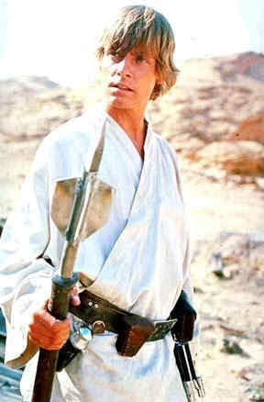
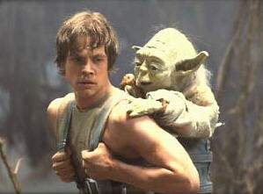
Archetypal Characters
THE HERO circumstances of birth may be unusual, some attempt is made at birth to kill him; raised by foster parents, returns to his kingdom to right wrongs, marries a princess, becomes king, meets a mysterious death, body is burned rather than buried
THE INITIATE—young heroes or heroines who go through training; usually innocent and wear white
MENTOR—teacher or counselor to the initiate; often are father or mother figures to the hero or heroine
VILLAIN—An antagonist that fights against the hero

Slide 4
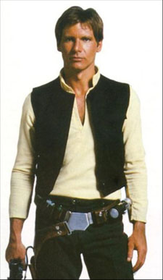
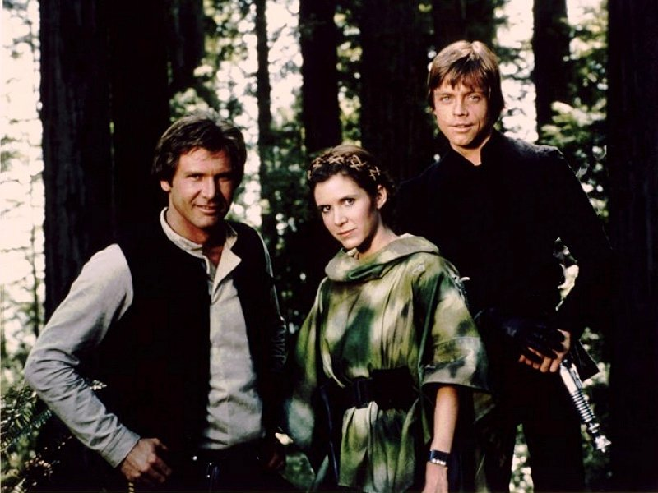
Archetypal Characters
OUTCAST—figure banished from a social group for some crime against his fellow man (could be falsely accused of a crime or could choose to banish himself from guilt)
EARTHMOTHER—offers spiritual and emotional nourishment to those she meets; shown in earth colors and has physical features symbolic of her childbearing capabilities
TEMPTRESS—sensuous beauty; brings about the hero’s downfall because he is physically attracted to her
PLATONIC IDEAL—female figure who provides intellectual stimulation for the hero; he is not physically attracted to her
STAR-CROSSED LOVERS—two lovers forbidden to be together because of the rules of society or family; often ends tragically
CREATURE OF NIGHTMARE—animal or creature disfigured or mutated; monsters who are the antagonists in the story

Slide 5
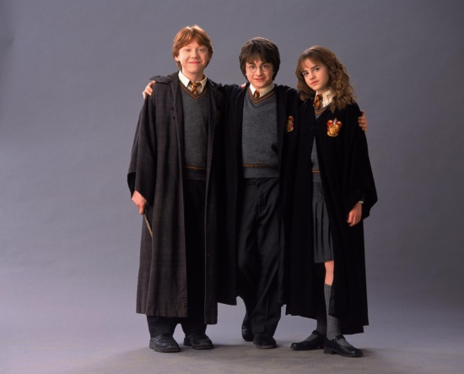
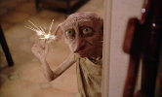
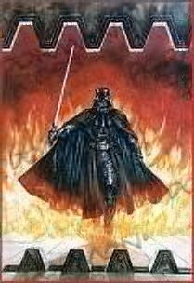
Archetypal Characters
HUNTING GROUP OF COMPANIONS—loyal companions willing to face any number of dangers to be together
LOYAL RETAINERS—somewhat like servants to the hero who are heroic themselves; their duty is to protect the hero and reflect the nobility of the hero; they are expendable
FRIENDLY BEAST—a beast on the side of the hero shows that nature sides most often with the forces of good
DEVIL FIGURE—evil incarnate; offers worldly goods, fame, or knowledge to the hero in exchange for possession of the soul
SCAPEGOAT—animal or human who is unjustly held responsible for others’ sins; sacrificed but they often become more powerful force dead than alive

Slide 6
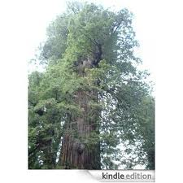
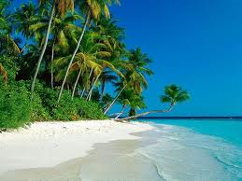
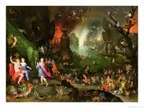
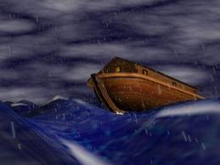
Archetypal Settings
Paradise, or ideal place where people live without strife or fear
Universe made up of opposites
Landscape that emerges from dark or watery emptiness or confusion
Circle that symbolizes completion
Giant tree that connects heaven and earth
Great flood and a ship that survives it
An underworld that people go to after they die

Slide 7
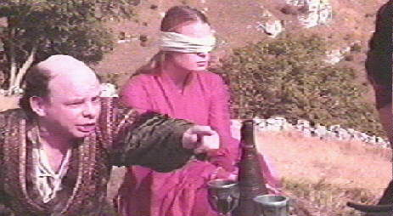
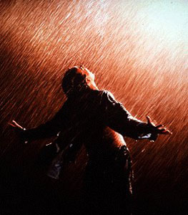
Archetypal Symbols
LIGHT and DARKNESS—light suggests hope, renewal, or intellectual illumination; darkness suggests the unknown, ignorance, or despair.
WATER and DESERT—water is necessary to life and growth and so it appears as a birth or rebirth symbol; the appearance of rain in a work can suggest spiritual birth or rebirth; characters who live in the desert are often “dead” to morals or the “good side”
HEAVEN and HELL—gods live in the skies or mountaintops; evil forces live in the bowels of the earth
NUMBERS- look for repeating numbers, especially 3 and 7
COLORS- characters may be wearing certain colors. White= purity/goodness, black= evil, blue= peace/heaven etc.

Slide 8
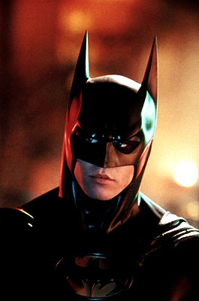
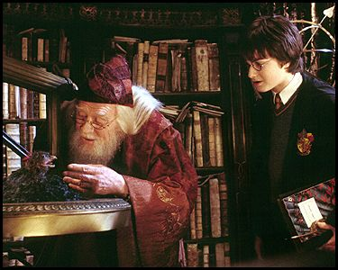
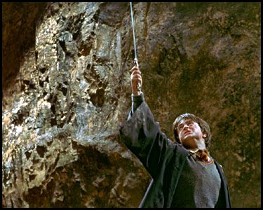
Archetypal Symbols
SUPERNATURAL INTERVENTION—the gods most often intervene on the side of the hero to assist him in his quest
HAVEN VS. WILDERNESS—for the hero, places of safety are required for time to regain health and resources; these hideouts are often in unusual places
FIRE VS. ICE—fire can represent knowledge, light, life, and rebirth while ice can represent ignorance, darkness, sterility, and death
MAGIC WEAPON—some object used to fight the forces of evil that has magical properties

Slide 9
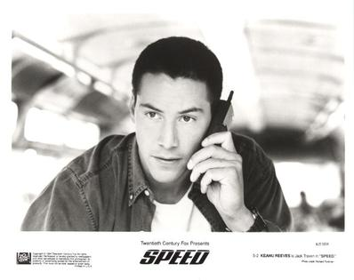
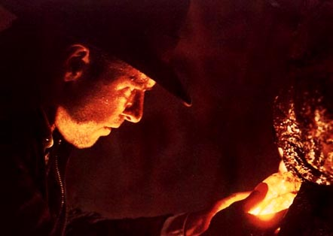
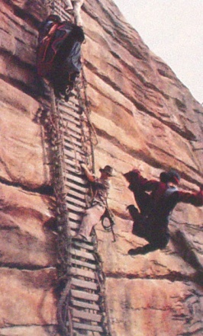
Archetypal Situations
THE QUEST—search for someone or some object, which when it is found and brought back will restore life to a wasted land, the desolation of which is shown by a leader’s illness and disability
THE TASK—to save the kingdom, to win the fair lady, to identify himself so that he may assume his rightful position, the hero must perform some nearly superhuman deed.
THE INITIATION—this usually takes the form of an initiation into adult life. The adolescent comes into his/her maturity with new awareness and problems along with a new hope for the community. This awakening is often the climax of the story.
THE JOURNEY—the hero goes in search of some truth or information to restore life to the kingdom; he must descend into a real or psychological hell and is forced to discover the blackest truths quite often concerning his faults; once the hero is at his lowest point, he must accept personal responsibility to return to the world of the living; this could also appear as a group of isolated people (trapped on a boat, bus, island) to represent society

Slide 10
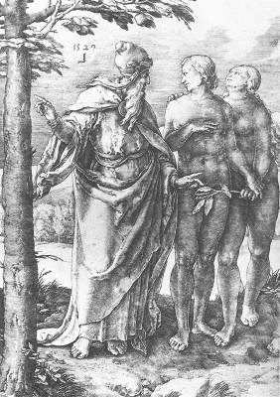
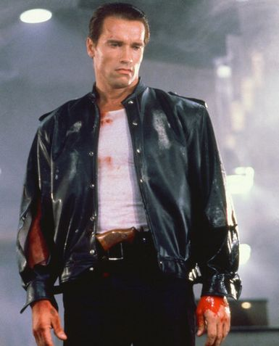
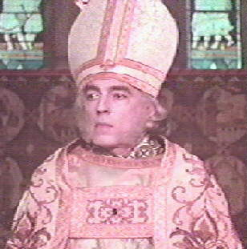
Archetypal Situations
THE FALL—describes a descent from a higher to a lower state of being. The experience involves a defilement and/or a loss of innocence and bliss. The fall is often accompanied by expulsion from a kind of paradise as a penalty for disobedience and moral transgression.
DEATH AND REBIRTH—grows out of a parallel between the cycle of nature and the cycle of life. Thus, morning and springtime represent birth, youth, or rebirth; evening and winter suggest old age or death.
NATURE VS. MECHANISTIC WORLD—Nature is good while technology and society are often evil.
BATTLE BETWEEN GOOD AND EVIL—Obviously the battle between two primal forces. Mankind shows eternal optimism in the continual portrayal of good triumphing over evil despite great odds.
THE UNHEALABLE WOUND—The wound is either physical or psychological and cannot be healed fully. This wound also indicates a loss of innocence. These wounds always ache and drive the sufferer to desperate measures.
THE RITUAL—The actual ceremonies the initiate experiences that will mark his rite of passage into another state (weddings, funerals)

Slide 11
Film Clip #1 - Shrek
Identify as many archetypes as you can from the clip and the rest of the film that you are familiar with.

Slide 12
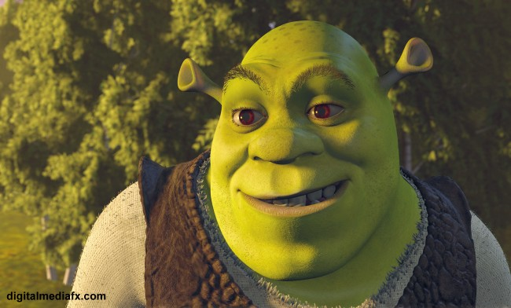
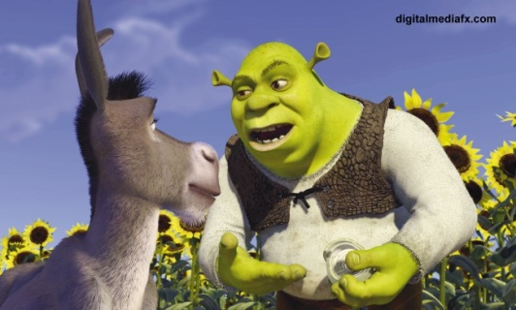
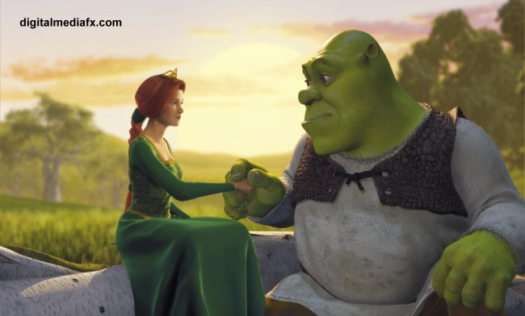
SHREK Archetypes
HERO—Shrek…literally doing superhuman deeds ( fighting fire breathing dragon)
QUEST—to find and rescue Princess Fiona
TASK—to get his swamp back from the fairy creatures
HUNTING GROUP OF COMPANIONS—Donkey is there to make Shrek’s humanity come out and show that he is not just an ogre at heart
FRIENDLY BEAST—Donkey
DAMSEL IN DISTRESS—Princess Fiona in the highest tower
HEAVEN VS. HELL—glowing embers and fire are shown to be the habitat of the dragon.
LIGHT VS. DARKNESS—the castle is dark to represent evil; Fiona is first seen in a ray of light; as soon as they escape, they emerge into daytime since they have escaped evil

Slide 13
SHREK Archetypes
DEATH AND REBIRTH—when they escape the dragon, morning is dawning suggesting hope and rebirth
BATTLE BETWEEN GOOD AND EVIL—Shrek and Donkey vs the Dragon
STAR-CROSSED LOVERS—Dragons and Donkeys aren’t supposed to be together
EVIL FIGURE WITH A GOOD HEART—Dragon appears at first as an Evil Figure, especially with the remains of the knights, but Donkey saves her and converts her to good
CREATURE OF NIGHTMARE—Dragon before she falls in love with Donkey
THE JOURNEY—Shrek and Donkey face their fears and conquer the dragon, finding Fiona to accomplish their task

Slide 14
Film Clip #2 – The Lion King
Watch the following clip and identify the major character, symbol, and situational archetypes.

Slide 15
Summarizer: Archetypes in The Lion King (on a Post-It and stick to wall on your way out )
The ____________archetype in the film, The Lion King, shows that society values…
(be specific and clear with explanation; also be concise)

