Slide 1
A Thousand Splendid Suns Contemporary Literature
Khaled Hosseini

Slide 2
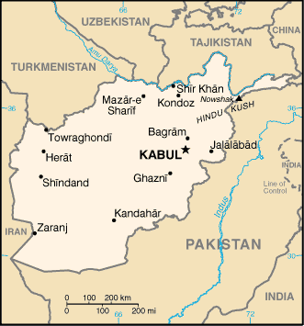
Setting
Afghanistan
Major Cities: Herat, Kabul
A couple fictional villages,
but most places are real
Story begins in late 60’s,early 70s
Ends in 2003
Encompasses great span of political turmoil in Afghanistan

Slide 3
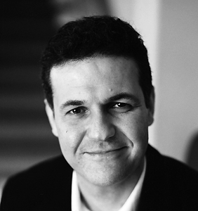
About the Author: Khaled Hosseini
Born in Kabul, Afghanistan 1965
Father worked for Afghan Foreign Ministry – constantly moved around due to violent political instability
Mother was a teacher of Persian Literature – gained passion for this poetry
Family moved to California in 1980 – Hosseini would graduate high school in Cali. and college with an M.D.
1st Novel: The Kite Runner, 2003
2nd Novel: A Thousand Splendid Suns, 2007
Both are highly acclaimed best-sellers

Slide 4
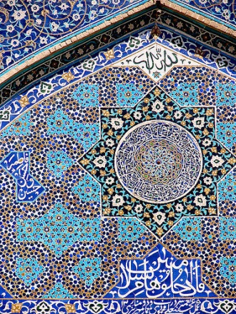
Title Inspiration:
Came from a poem by 17th century Persian poet Saib-e-Tabrizi
“Every street of Kabul is enthralling to the eye Through the bazaars, caravans of Egypt pass One could not count the moons that shimmer on her roofs And the thousand splendid suns that hide behind her walls”
*We will look at the poem as tomorrow’s voice lesson..

Slide 5
“Kabul”
Read the poem
Make a list of the images the poet uses to praise the city of Kabul.
This poem is an ode. An ode uses hyperbole and inflated language to glorify and enhance the subject and to create feelings of appreci­ation in the listener.
What do you learn about Kabul from read­ing this poem?
What is your favorite image in this poem?
What is the poet’s purpose?
Does the poet succeed in creating a sense of the beauty of Kabul?

Slide 6
Novel’s Influences
Treatment of women under the rule of the Taliban
Political turmoil of Afghanistan over the past 30 years
Beauty of a country that lies hidden beneath a violent political past

Slide 7
Political Circumstances:
Main conflicts in switching governments: modernizing Afghan culture or keeping with old traditional ways (i.e. – women being allowed education, wearing burqas…)
Soviet Union also infiltrating (basically want more power geographically)
Taliban is one reactionary group which gained strong control throughout Afghanistan
In a war-ridden country, many people took refuge in the neighboring countries of Pakistan and Iran

Slide 8
Marriage Rights:
Polygamy is socially accepted
Wives expected to do domestic chores
Generally wives all live in the same house
Certainly not all men were abusive to wives – but public would generally turn heads to obvious abuse
Men could choose how they wanted their wives to behave – burqa, go in public alone…

Slide 9
Women:
Before the Taliban take over, women’s role in society was beginning to modernize (in more urban areas)
Allowed education
Dress code was lightened – could wear just a loose scarf over head, could wear lipstick, nail polish, high heels
Voting rights granted in select areas
With Taliban, women basically lose all forms of freedom

Slide 10
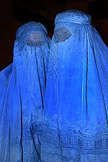
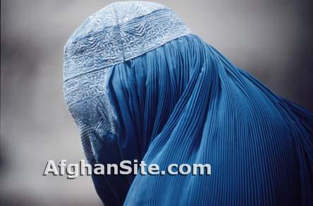
Under Taliban:
Aim was to “secure environments where the chasteness and dignity of women may once again be sacrosanct,"
Forced to wear Burqa – “face of a woman is a source of corruption”
Could not be in public without male escort

Slide 11
Taliban Continued:
Not allowed to work
Could not be educated past age 8
Could only read Koran
Not allowed to be treated by doctors unless escorted – led to diseases that never got treated
Women were publicly punished if they broke these laws – beaten, shot, hanged, stoned…
Countless more inhumanities suffered upon the Afghan women

Slide 12
Afghanistan Today
Now titled the Islamic Republic of Afghanistan – has a president and a parliament
International powers are trying to help reform the political infrastructure, although Taliban and other insurgent groups still have considerable power
Small gains in women’s rights have been made (right to vote), but certainly nowhere close to the freedoms that women in our world have
Remains a very unstable environment where many people live in constant fear

Slide 13
Perspective
Told from two different women’s perspective at different points in their lives.
Mariam- illegitimate child of a rich man and a housekeeper- 15 years old when story starts
Laila- child of loving and progressive parents- believes in woman’s education and rights- 9 years old when story starts
Story divided into 4 parts:
1. Mariam
2. Laila
3. Switches between Mariam/Laila
4. Laila
Provides a compelling view of Afghan society from two very different women as their journeys through life collide unexpectedly

Slide 14
Thematic Concepts and Themes
Man’s inhumanity to man
Systematic victimization of women by patriarchal institutions
Resistance to victimization
Power of education
Education for women
Corrupting influence of absolute power
Inner strength of women
Enduring the unendurable
Finding hope in midst of despair
Discovering strength in an unlikely companion
Human capacity for evil
Loyalty and devotion

Slide 15
Archetypes:
Good vs. Evil
The cast-out child
Female suppression
Star-crossed lovers
Controlling husband
Tragic Hero

