Slide 1
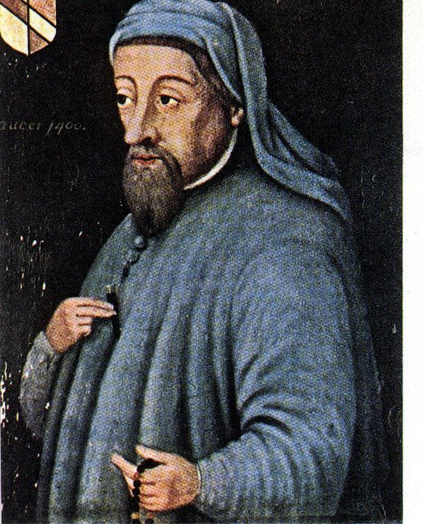
Geoffrey Chaucer Background Notes

Slide 2
Bio
Born around 1344 – though this date, like so much else in his life is based on inference, he may have been born a few years earlier. He was probably born at home in the wine-marketing area of London, the Vintry, a short distance from the bank of the Thames.
Son of a prosperous London wine merchant – John Chaucer
He was well educated. In mid teens, he was placed in the service of the Countess of Ulster so he could obtain more education and be schooled in court and society life. He also studied law at the Inner Temple
Thus, he would have learned Latin and some Greek as well as perhaps some French and Italian

Slide 3
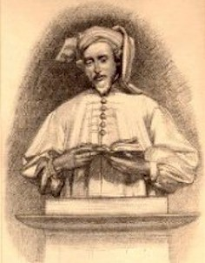
Bio (continued)
In, 1359 he was captured by the French during the Hundred Years' War while serving in English army; ransomed by King Edward III a year later.
Nothing is known about Chaucer’s life following March 1, 1360, when the ransom was paid.
Chaucer joined the royal household of King Edward III and became a trusted messenger and minor diplomat.

Slide 4
Bio (continued)
From 1367 to 1386, as a member of the royal household Chaucer seemed to have prospered greatly. He was frequently called upon to make trips abroad in service of the King.
In 1374 Chaucer was made Controller of the Customs and Subsidies on Wool for the port of London. In 1385 he was appointed as a Justice of Peace and held that position until 1386.
He retired early and around 1388, he was badly in debt and no longer received royal annuity. His retirement came to an end in 1389 when King Richard II appointed Chaucer Clerk of London. He held that position until 1399.
According to the tomb in Westminster Abbey - He died October 25, 1400.

Slide 5
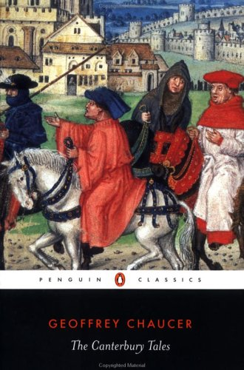
In The Canterbury Tales, Chaucer wrote about the people he had met along the way…

Slide 6
If you were doing the same thing today, think about the variety of types of people you know and have encountered. You would describe them by:
Their job
The type and color of their clothing
Their “accessories” (jewelry, pets, other portables)
The way they act
Their income
Their “secrets”
Their status in society as a whole
The way they speak / their slang or accent
Their mode of transportation

Slide 7
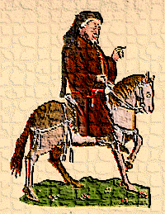
Chaucer’s Plan ...
The original plan would have included about 120 tales!
A General Prologue followed by a series of stories and linking dialogues and commentaries
Each character would tell 2 stories going to Canterbury and 2 stories returning to London
If Chaucer would have finished his work, it would have been the longest poem in the English language.

Slide 9
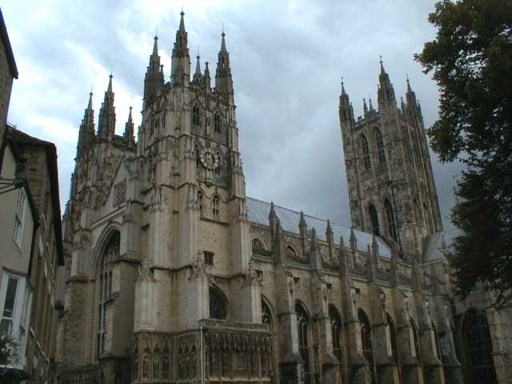
But why go to Canterbury?

Slide 10
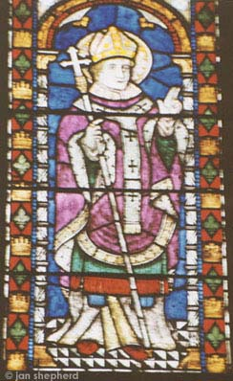
One Answer: Religion
Canterbury has always been an important religious center in England.
St. Augustine (seen in stained glass from the Canterbury Cathedral) was sent by Pope Gregory the Great to establish the Catholic faith in the country
Religion played an important part in medieval life.

Slide 11
Why was religion important?
It was the Middle Ages…
Plague
Warfare
High Infant Mortality Rate
Short Life Expectancy
…and if you were a peasant, you lived your whole life in harsh conditions…About the best thing that you had to look forward to was dying and going to Heaven

Slide 12
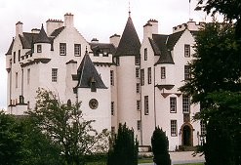
England was divided among very strict class/economic lines; thus, Heaven was often described as a white shining castle in the sky.

Slide 13
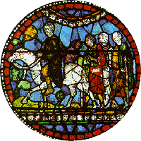
Canterbury was a Pilgrimage Site…
People of all classes went on pilgrimages to holy sites to ask for help with medical, financial or other problems.

Slide 14
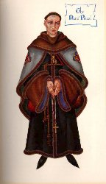
The fact that Chaucer wrote in English (Middle English), rather than French or Latin like many of his fellow writers, meant that ordinary folk could enjoy The Canterbury Tales and their vivid characters. He composed the Canterbury Tales as if her were going to read them aloud.

Slide 15
The late fourteenth century world was still very much one of the spoken word. Books were copied out by hand and were a rare luxury till the advent of the printing press 70 years later. The educated elite could read, but they preferred to hear texts read out loud for entertainment. The Canterbury Tales, with their earthy humor and vivid dialogue, were a success and appealed to all.

Slide 16
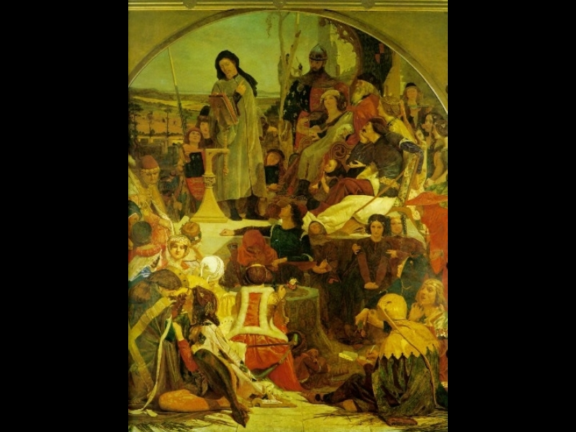
Chaucer surrounded by his characters.

