Slide 1

Vocabulary #10

Slide 2

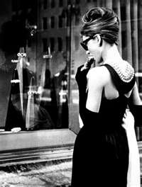
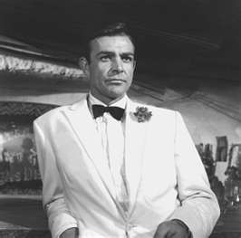

Retro: back, behind, or backward
Retroactive—having an effect
on things that are
already past

Slide 3
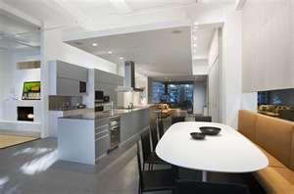
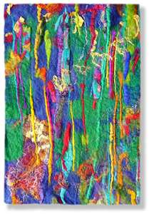
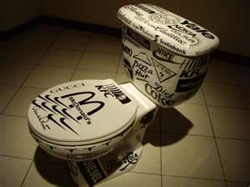
Tempor: time
Contemporary—of the present time, modern

Slide 4
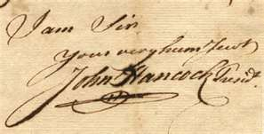
Sign: sign or mark
Signature—a person’s name written by that person
Signal—a sign or event that initiates action

Slide 5
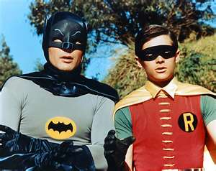

Di/duo: two
Duo—a pair, a couple
Dichotomy—division into
two parts or groups

Slide 6
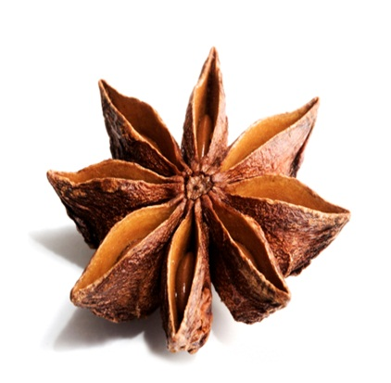


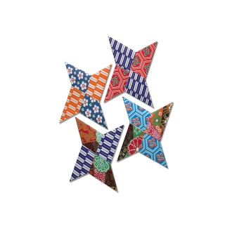

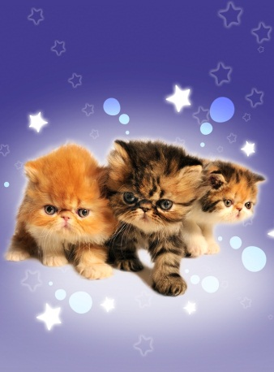
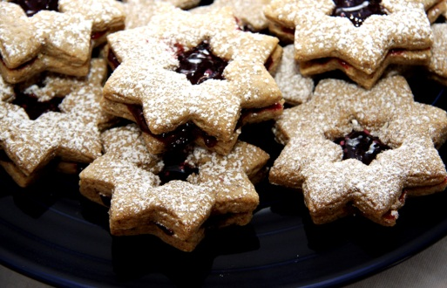
Ast(er): star
Astronomy—the science that studies the origin, size, motion, etc., of stars, planets, etc.

Slide 7
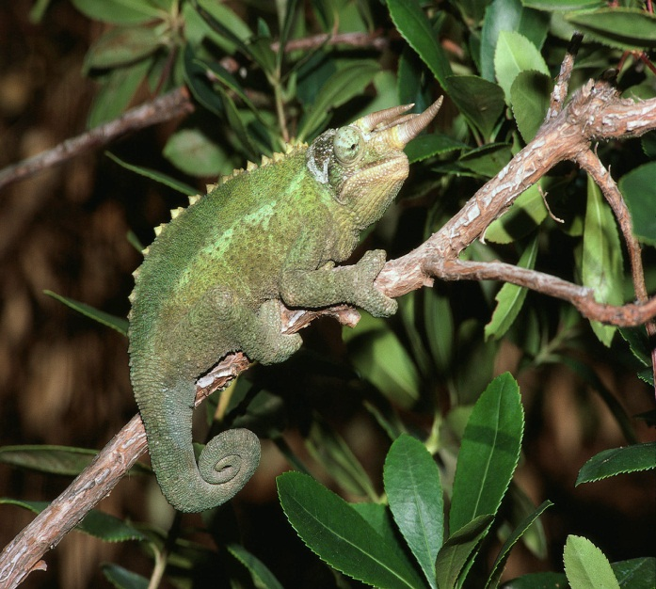
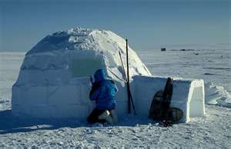
Prefix
Ad-: toward
Adapt—to make suitable, especially by changing
Advance—to bring forward

Slide 8

Suffix
---mania: obsession
Kleptomania—a persistent,
abnormal impulse to steal
Ablutomania—obsession with
washing one’s self
Trichotillomania—craving for pulling out one’s hair
Onomatomania—irresistible desire to repeat certain words
Gamomania—obsession with issuing marriage proposals

