Slide 1
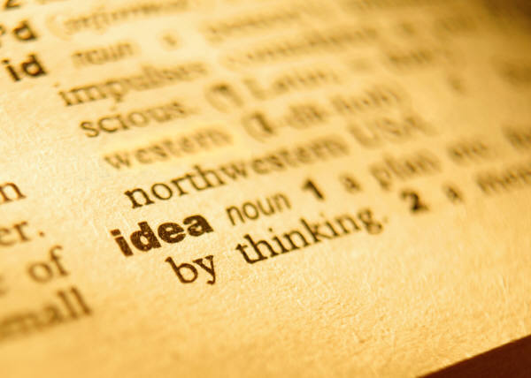
Vocabulary #7

Slide 2
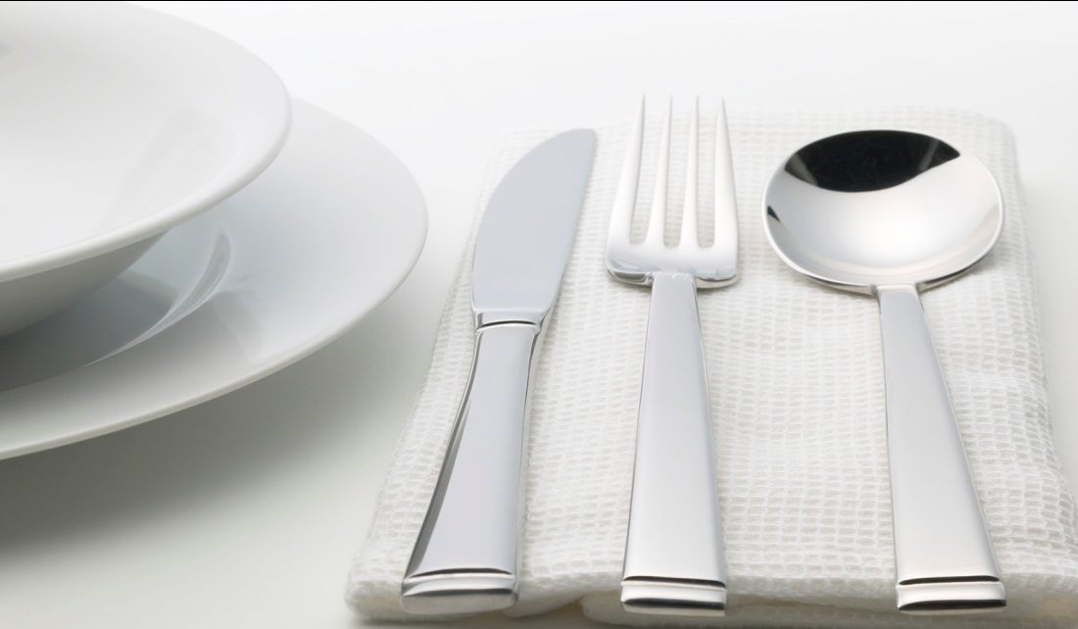
Pon/pos: put or place
Position—the way in which a person or thing is placed or arranged
Pontificate—to be pompous

Slide 3
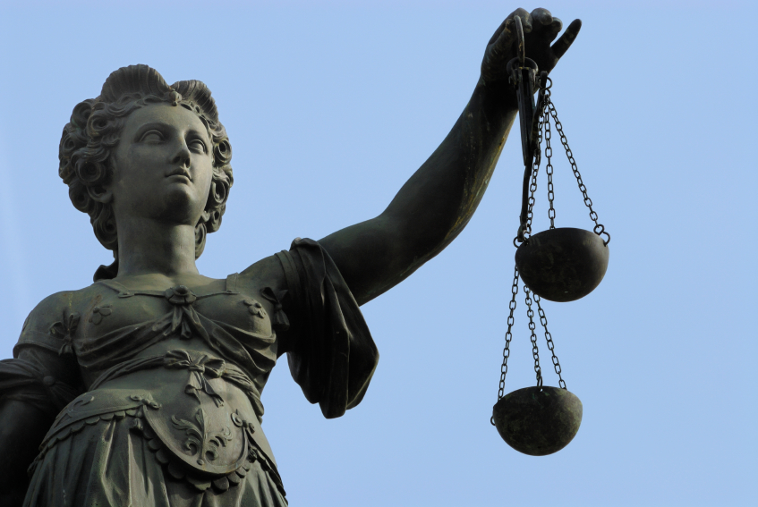
Jur/jus: law
Justice—fairness; righteousness
Jury—a group of people
sworn to hear evidence
in a law case and give a
decision

Slide 4
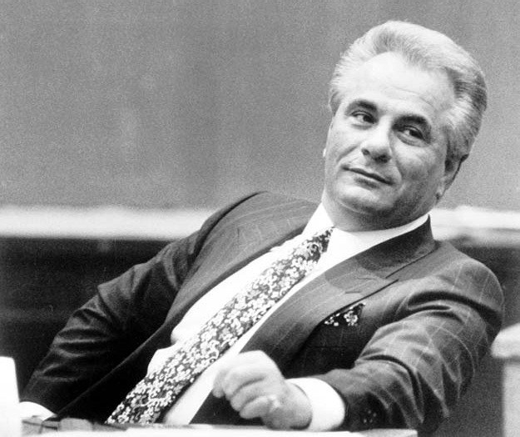
Put: to think, consider or believe
Reputed—commonly regarded as such; supposed

Slide 5
Log: word; speech; reason
Logic—correct reasoning
Dialogue—interchange of ideas
by open discussion

Slide 6
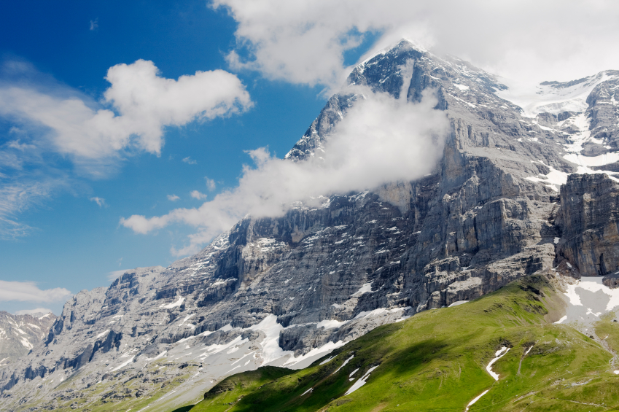
Terr: land; earth
Terrain—a tract of ground, as with regard to its features

Slide 7
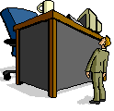
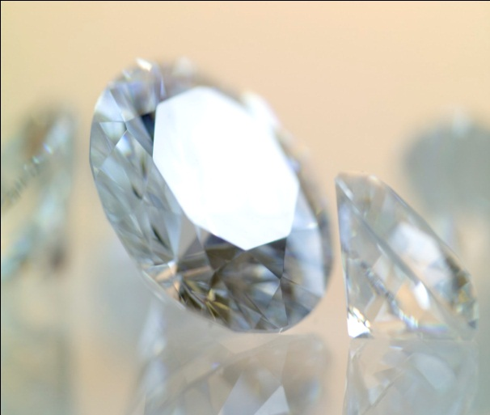
Prefix Super-: above
Superior—
1. Higher in space, rank, order
Greater in quality
Superb—rich or
magnificent

Slide 8
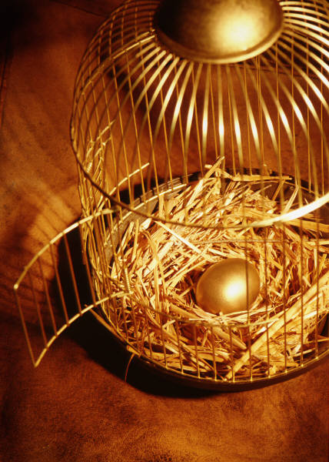
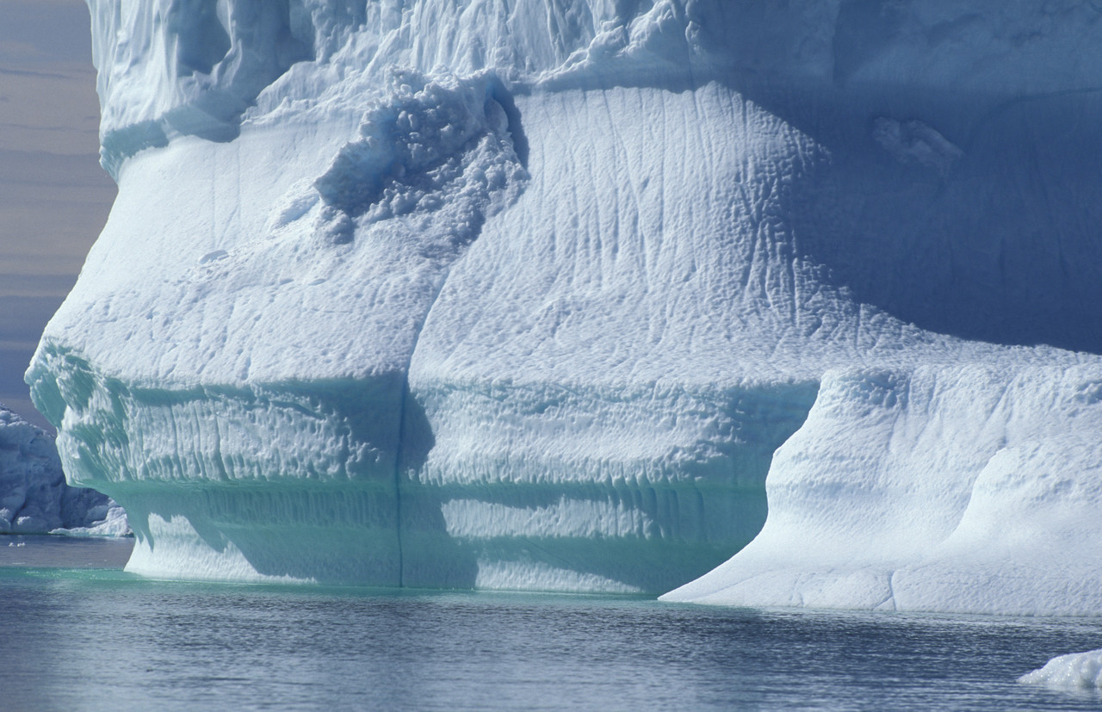
Suffix --en: made of
Golden: Frozen:

