Slide 1
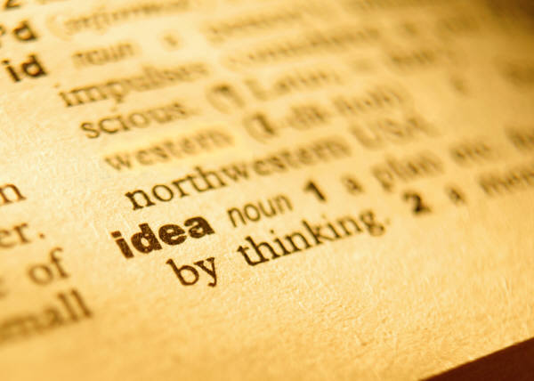
Vocabulary #9

Slide 2
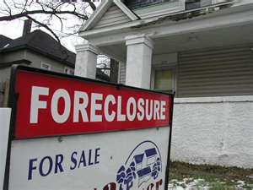
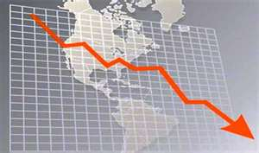
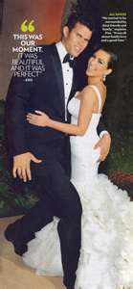
Top: commonplace
Topical—pertaining to or dealing with matters or current or local interest

Slide 3
Centr/centre: sharp point; center of a circle
Center stage—the center point of a stage
Ethnocentrism—the belief in the inherent superiority of one’s own ethnic group or culture

Slide 4
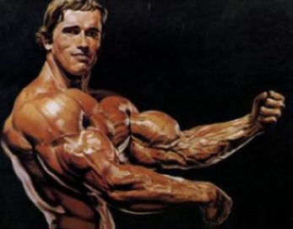
Dom: house; master
Dominant—ruling or controlling; occupying or being in a commanding or elevated position; main, major
Domestic—of or pertaining to the home

Slide 5
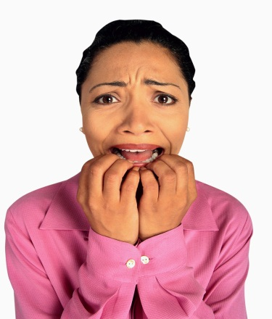
Habit/hibit: to have; to hold
Prohibit—to forbid (an action, activity, etc.) by authority or law
Habit—an acquired behavior
pattern regularly followed
until it has become almost
involuntary

Slide 6
Photo: light
Photosynthesis—the synthesis of complex organic materials, using sunlight as the source of energy

Slide 7
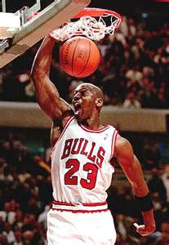
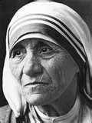
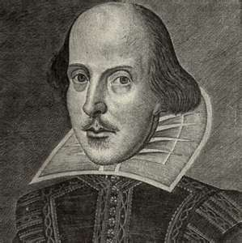
Prefix Ex-: out or outside
Extraordinary—beyond what is usual, ordinary, regular, or established; exceptional

Slide 8
Suffix ---cracy: rule
Democracy—government by the people

