Slide 1
Vocabulary 1

Slide 2
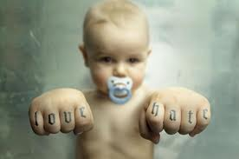
ABHOR – To hate

Slide 3
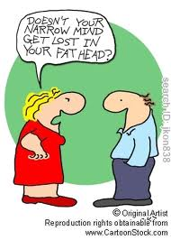
Bigot - Narrow-minded person

Slide 4
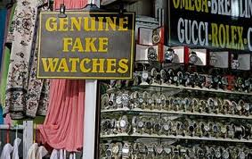
counterfeit – fake; false

Slide 5
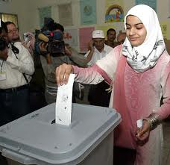
enfranchise – give voting rights

Slide 6
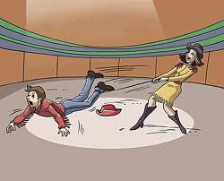
hamper – hinder; obstruct

Slide 7
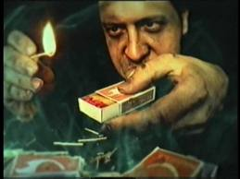
kindle – to start a fire

Slide 8
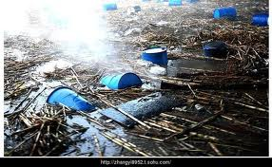
noxious – harmful; poisonous; lethal

Slide 9
placid – peaceful; calm

Slide 10
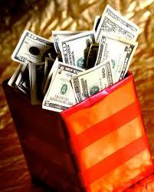
remuneration – payment for work done

Slide 11
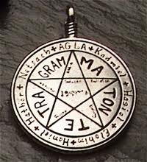
talisman – good luck charm

