Slide 1
Vocabulary 2

Slide 2
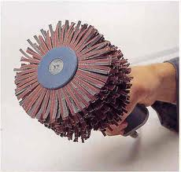
Abrasive-rough, coarse, harsh

Slide 3
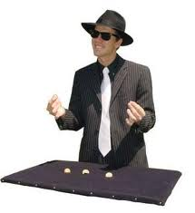
Bilk-cheat, defraud

Slide 4
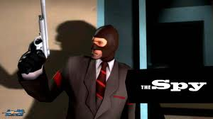
Covert-hidden; undercover

Slide 5
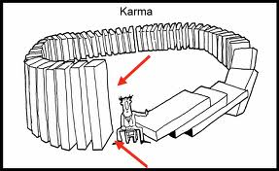
Engender-to cause

Slide 6
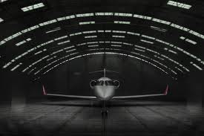
Hangar-storage area for a plane

Slide 7
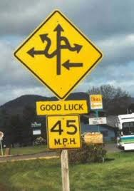
Knotty-complex; difficult to solve

Slide 8
Nuance-something subtle; fine shade of meaning

Slide 9
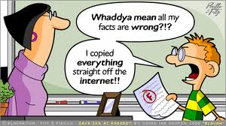
Plagiarism-taking credit for someone else’s writing or ideas

Slide 10
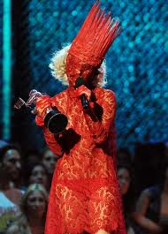
Renown-fame

Slide 11
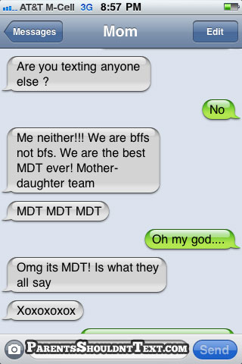
Tangent-going off the main subject

