Slide 1
Vocabulary 3

Slide 2
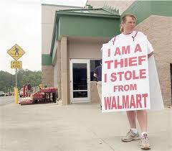
Abasement- humiliation;degradation

Slide 3
Billowing-swelling; fluttering; waving

Slide 4
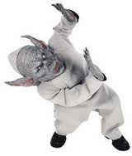
Cower-recoil in fear; shrink away from

Slide 5
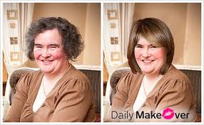
Enhance-improve; make better or clearer

Slide 6
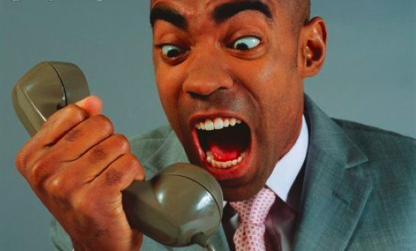
Harangue- noisy attacking speech

Slide 7
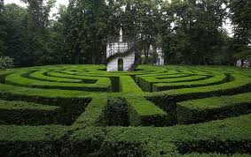
Labyrinth – a maze

Slide 8
Nullify – to counter; make unimportant; to void

Slide 9
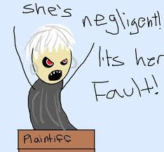
Plaintiff – petitioner in a court of law

Slide 10
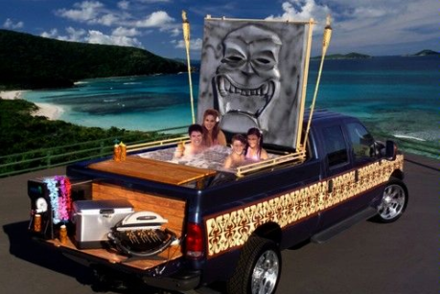
Replete - full

Slide 11
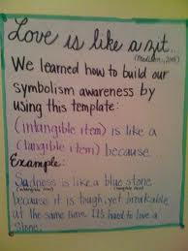
Tangible – can be touched

