Slide 1
Vocabulary 4

Slide 2
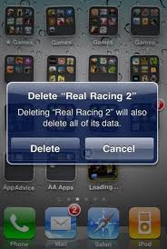
Abrogate: cancel; deny; repeal

Slide 3
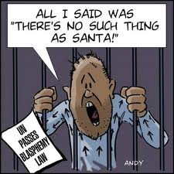
Blasphemy: speech which offends religious sentiments

Slide 4
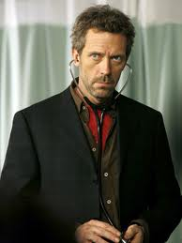
Credible: believable

Slide 5
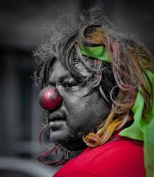
Enigma: mystery; puzzle

Slide 6
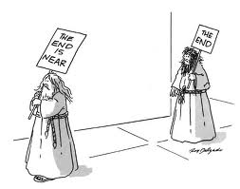
Harbingers: bringers of warning; indicators

Slide 7
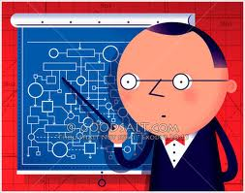
Labyrinthine: complicated; highly convoluted

Slide 8
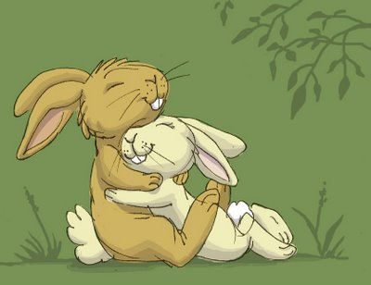
Nuzzle: cuddle; snuggle

Slide 9
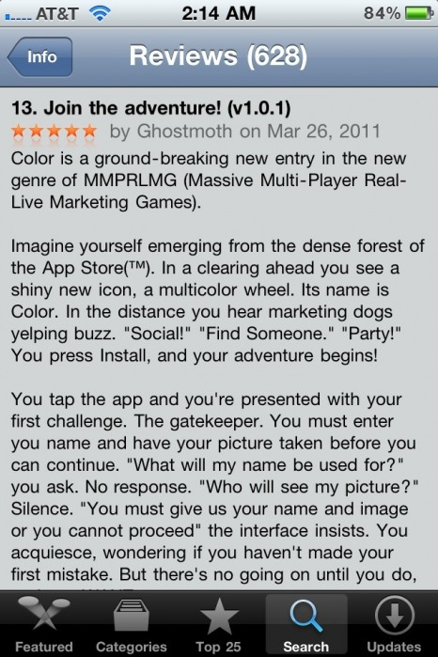
Plaudit: statement giving strong praise

Slide 10
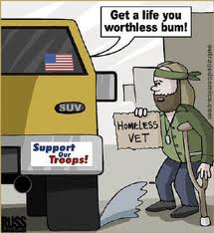
Reprehensible: shameful; very bad

Slide 11
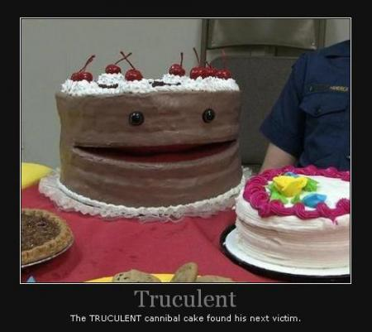
Truculent: ready to fight; cruel

