Slide 1
Vocabulary 5

Slide 2
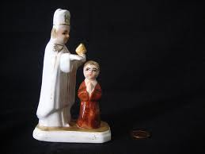
Absolution: forgiveness; pardon; release

Slide 3
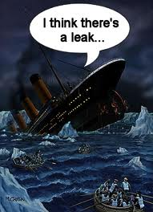
Blatant: obvious

Slide 4
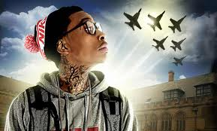
Creditable: praiseworthy

Slide 5
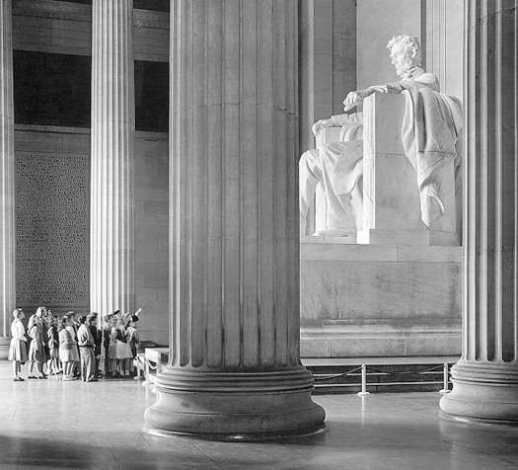
Ensconce: establish firmly in a position

Slide 6
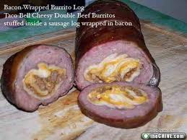
Hasten: hurry; accelerate; rush

Slide 7
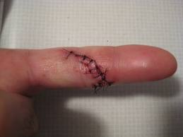
Laceration: cut

Slide 8
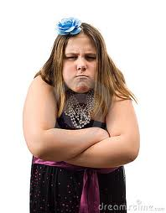
Obdurate: stubborn

Slide 9
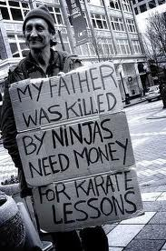
Plausible: believable; reasonable

Slide 10
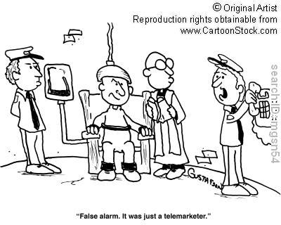
Reprieve: postponement of a sentence

Slide 11
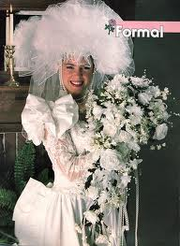
Tawdry: of little value; gaudy

