Slide 1
Vocabulary 8

Slide 2
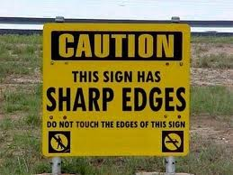
Abstruse: Difficult to understand

Slide 3
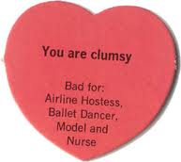
Blunderbuss: ancient weapon (gun); a clumsy person

Slide 4
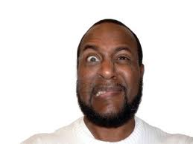
Cringe: recoil; flinch; shy away

Slide 5
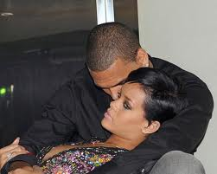
Envenom: to cause bitterness and bad feeling

Slide 6
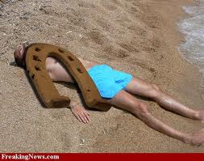
Hapless: unlucky

Slide 7
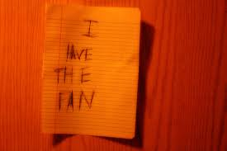
Laconic: using few words; brief; to the point

Slide 8
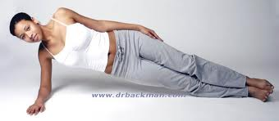
Oblique: indirect; slanting

Slide 9
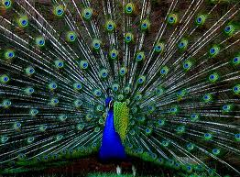
Plumage: feathers of a bird

Slide 10
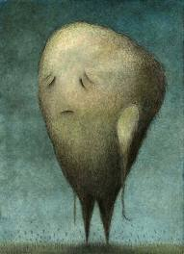
Resignation: acceptance of fate

Slide 11
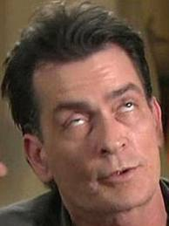
Temerity: audacity; recklessness

