Slide 1
Vocabulary 9

Slide 2
Accolade: Tribute; honor; praise

Slide 3
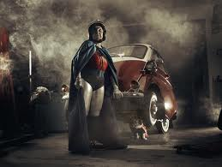
Bolster: support; prop up

Slide 4
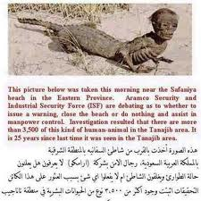
Cryptic: puzzlic; enigmatic

Slide 5
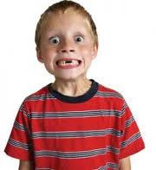
Ebullient: extremely lively and enthusiastic

Slide 6
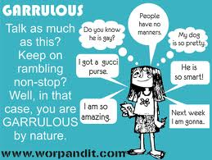
Garrulous: talkative; wordy

Slide 7
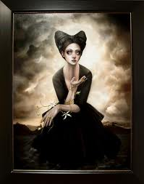
Lamentation: expression of regret or sorrow

Slide 8
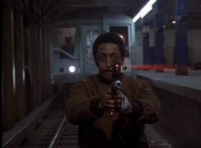
Obliterate: destroy; demolish; eradicate

Slide 9
Plummet: fall suddenly and steeply

Slide 10
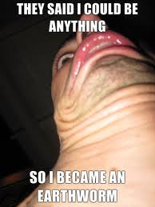
Resolution: determination

Slide 11
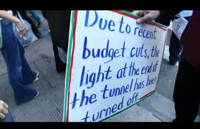
Tentative: not certain

