Slide 1
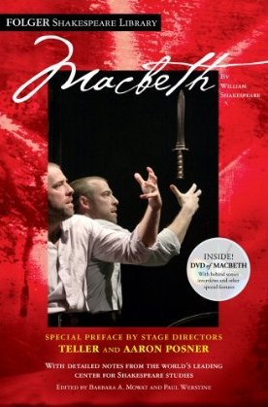
Who’s Who in Macbeth

Slide 2
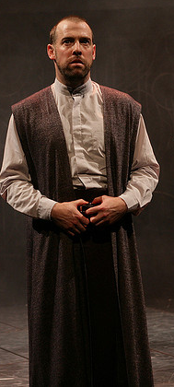
Macbeth -Thane of Glamis -Loyal to King Duncan -Devoted servant -Caring -Tempted by the Three Witches -Begins to wonder “What if?” -Fatal Flaw: Ambition -His ambition begins to take over his world

Slide 3
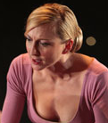
Lady Macbeth -Bitter over the loss of her child -Encourages Macbeth to go against Duncan -heartless, ruthless

Slide 4
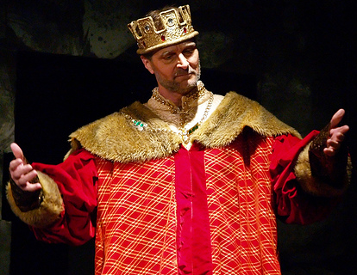
King Duncan -King of Scotland -noble and caring -a great king -father of Malcolm and Donalbain

Slide 5
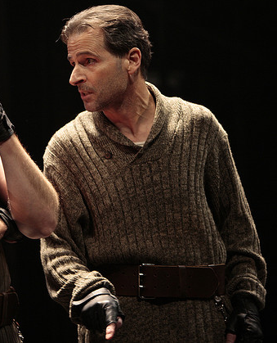
Banquo -Macbeth’s best friend -Loyal to King Duncan -brave and noble -Witches predict his children will be kings -does not act on the prophecies -becomes suspicious

Slide 6
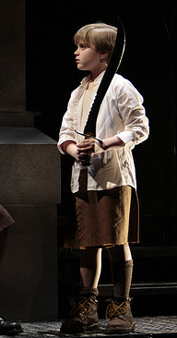
Fleance -Banquo’s son -prophesied to be a future king of Scotland -escapes an attempt on his life

Slide 7
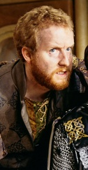
Macduff -Scottish nobleman -loyal to King Duncan -become suspicious of Macbeth -begins crusade to put Malcolm on the throne -wants revenge

Slide 8
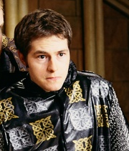
Malcolm -Duncan’s oldest son -rightful heir to the throne of Scotland -at times, appears unconfident -will rise to the occasion when necessary

Slide 9
Hecate - Queen of the Witches

Slide 10
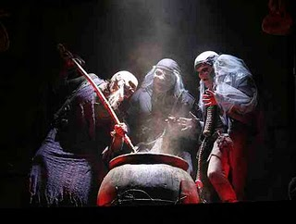
The Three Witches -they plot mischief using charms, spells, and prophesies; servants of Hecate

Slide 11
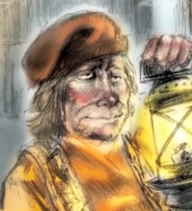
The Porter – castle doorman; a drunkard; provides comic relief

Slide 12
Lady Macduff and her son Macduff’s wife; innocently waits for her husband to return

Slide 13
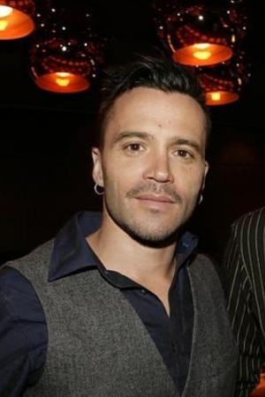
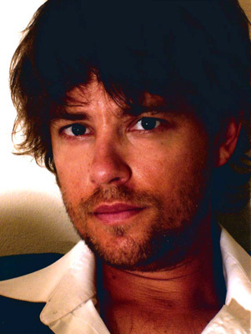
Ross
Lennox
Angus
Scottish Noblemen
loyal to Duncan and Scotland

Slide 14
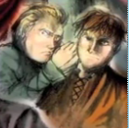
Donalbain -Duncan’s youngest son -fears that his life is in danger

Slide 15
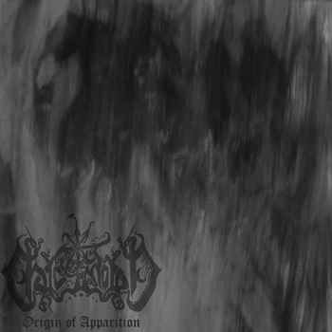
The Three Apparitions… Three visions that rise out of The Witches’ cauldron to show Macbeth his future

Slide 16
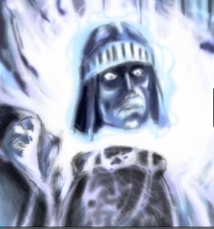
An Armed Head warns Macbeth to “Beware Macduff!”

Slide 17
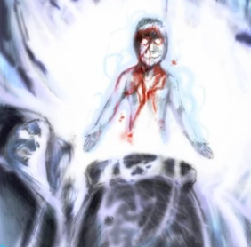
warns Macbeth “not to fear any man not born of a woman”
A Bloody Child

Slide 18
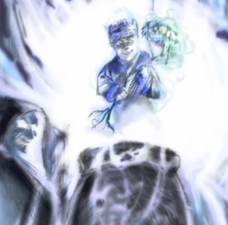
A Crowned Child
warns Macbeth that he “will not be defeated until Burnham Wood marches to Dunsinane Castle”

Slide 19
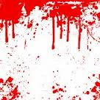
There are more… But they will be revealed in time…

Slide 20
Act 1 Pre-Reading Journal
Take out a blank sheet of paper and title it with the above title. Write your name at the top.
Now, think about these 2 words:
FATE & FREE WILL
Put in your headphones and complete a “free write” with your thoughts. Maybe you start with, “which one do you think is more influential?” and see where it goes from there.
The most important rule is that you try to stay on topic (in your own unique way) and that you don’t stop writing for the full ten minutes.

