Slide 1
The Iliad The Prequel to The Odyssey by Homer

Slide 2
Write a summary of The Odyssey

Slide 3
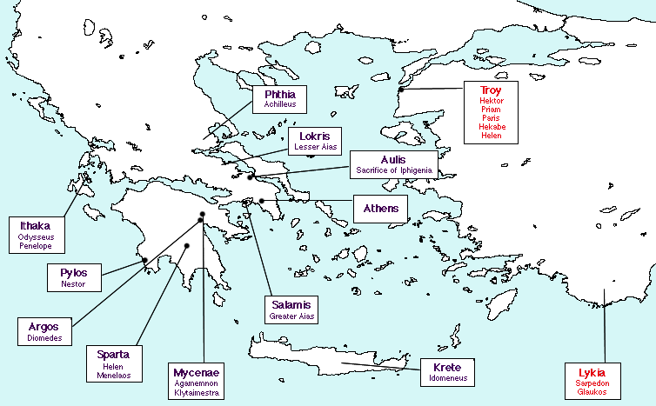

Slide 4
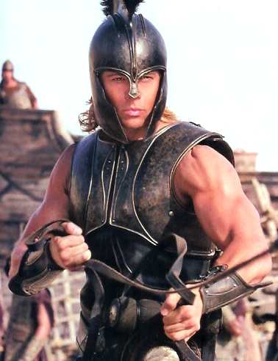
Achilleus
Son of King Peleus
and the Sea-Goddess Thetis
Greatest warrior of the Achaians
Leader of the Myrmidons
Falls in love with Briseis
of Troy

Slide 5
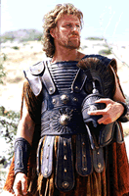
Odysseus
•King of Ithaca
•Goes to Troy to fight
with the Greeks
•Finds a way to get through
the Walls of Troy
Cunning!
Uses his brain!

Slide 6
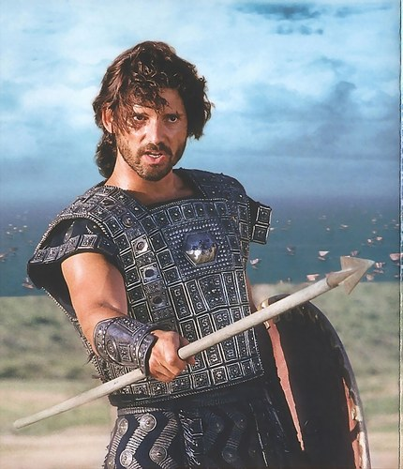
Hektor
Prince of Troy
Troy’s Greatest Warrior
Leader of the Trojans
Married to Andromache

Slide 7
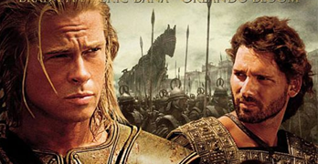
Achilles vs. Hektor

Slide 8
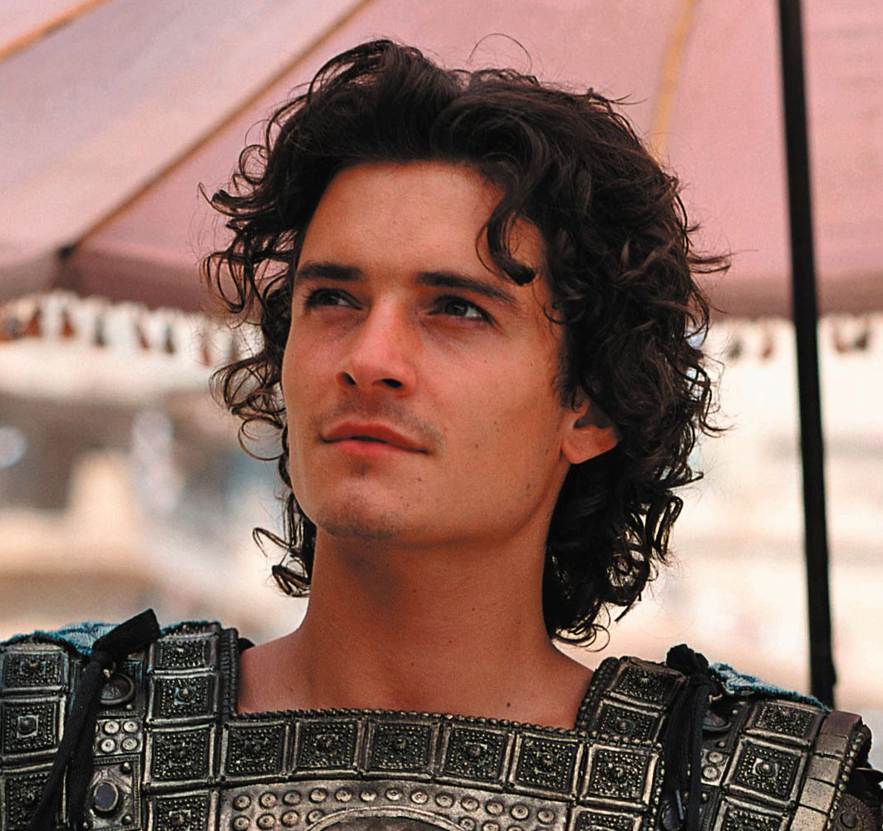
Paris •Prince of Troy •Hektor’s brother •Abducts Helen of Sparta

Slide 9
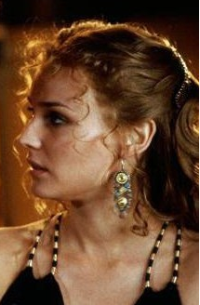
Helen •The most beautiful woman in the world •Queen of Sparta •Wife of Menelaus •Flees to Troy with Paris •”The Face that Launched a Thousand Ships”

Slide 10
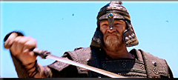
Menelaus •King of Sparta •Husband of Helen •Goes to Troy to avenge the abduction of Helen

Slide 11
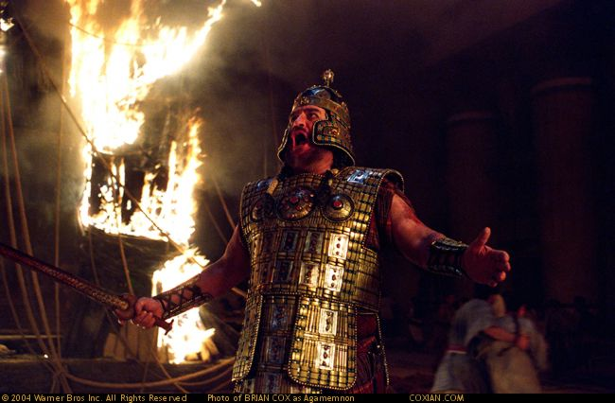
Agamemnon
King of Mycenae
Leader of Greek Forces
Brother of Menelaus
Hates Achillies

Slide 12
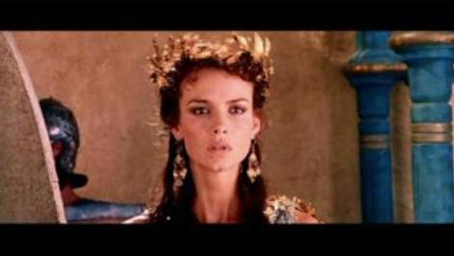
Andromache
Wife of Hektor

Slide 13
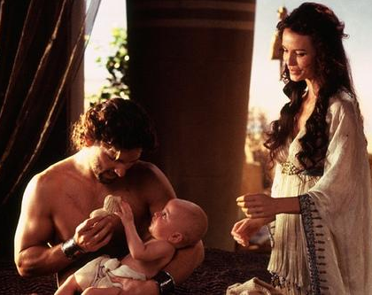
Astyanax
Son
of
Hektor
and
Andromache
•Prince of Troy

Slide 14
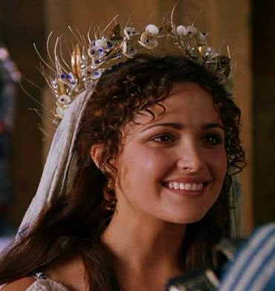
Breseis – “The Spoils of War”
•Achilles
loves
Breseis
BUT!...
•Agamemnon
wants her for
his own

Slide 15
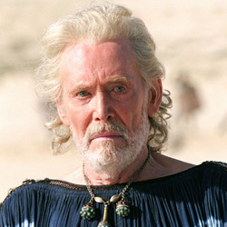
Priam
•King of Troy
•Devoted to his country
and his people

Slide 16
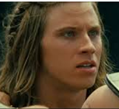
Patroklus
•Cousin
of
Achilles
•Achilles
dearly loves
him

Slide 17
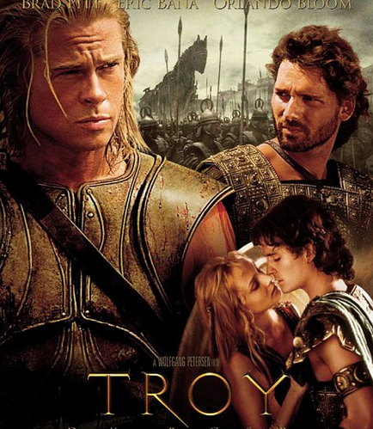
The Iliad

